Slide 1
UI Analysis

Slide 2
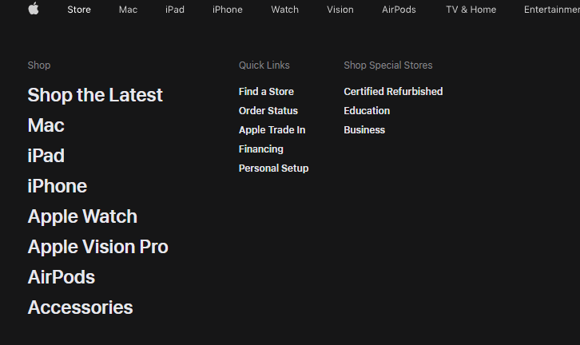
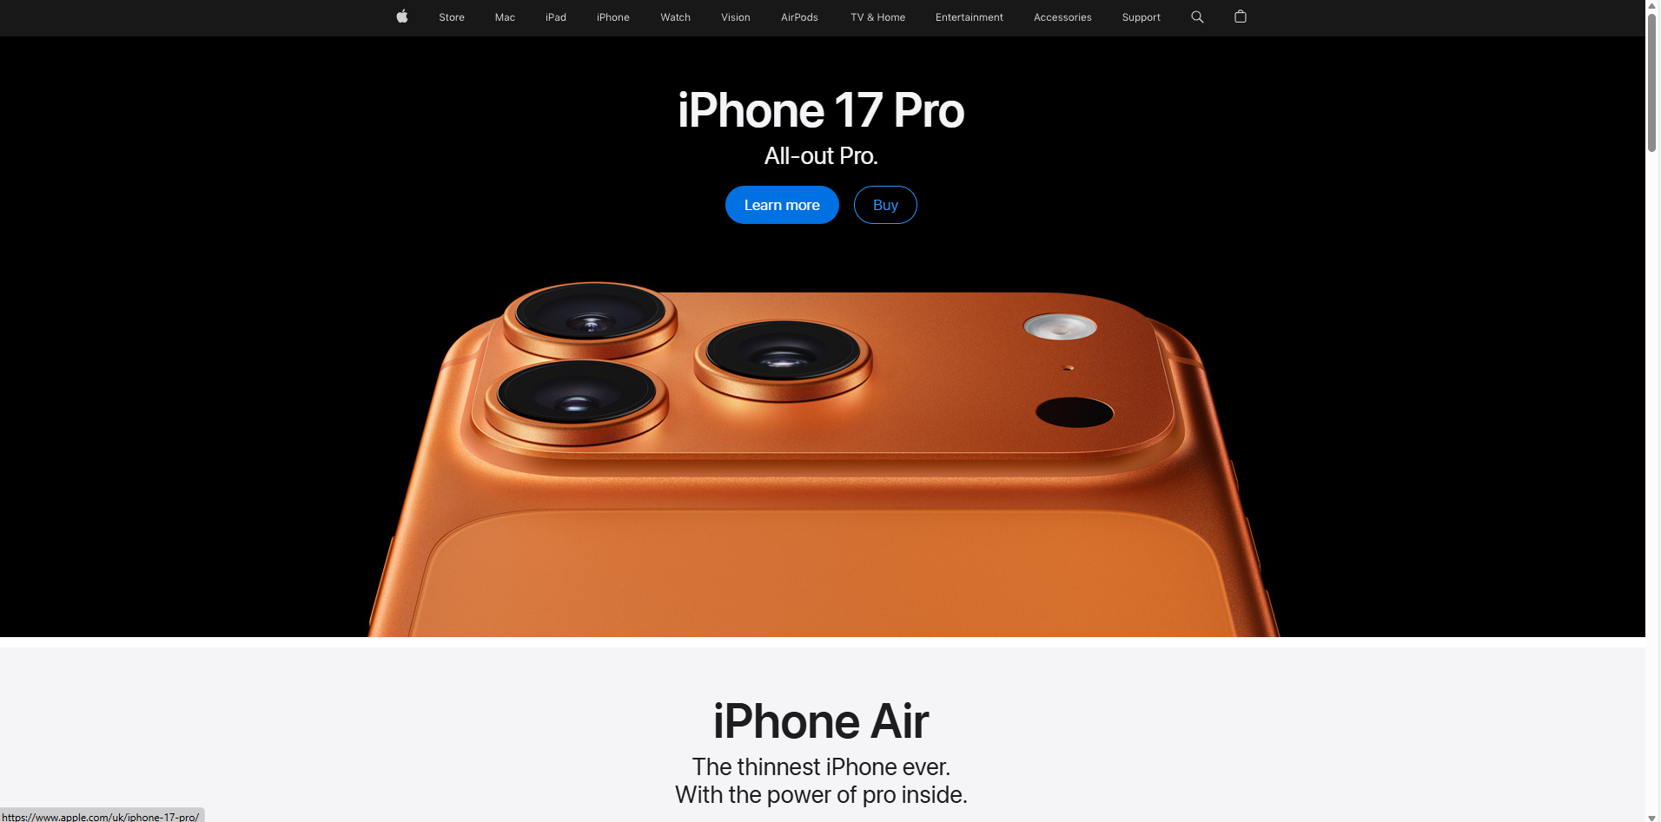
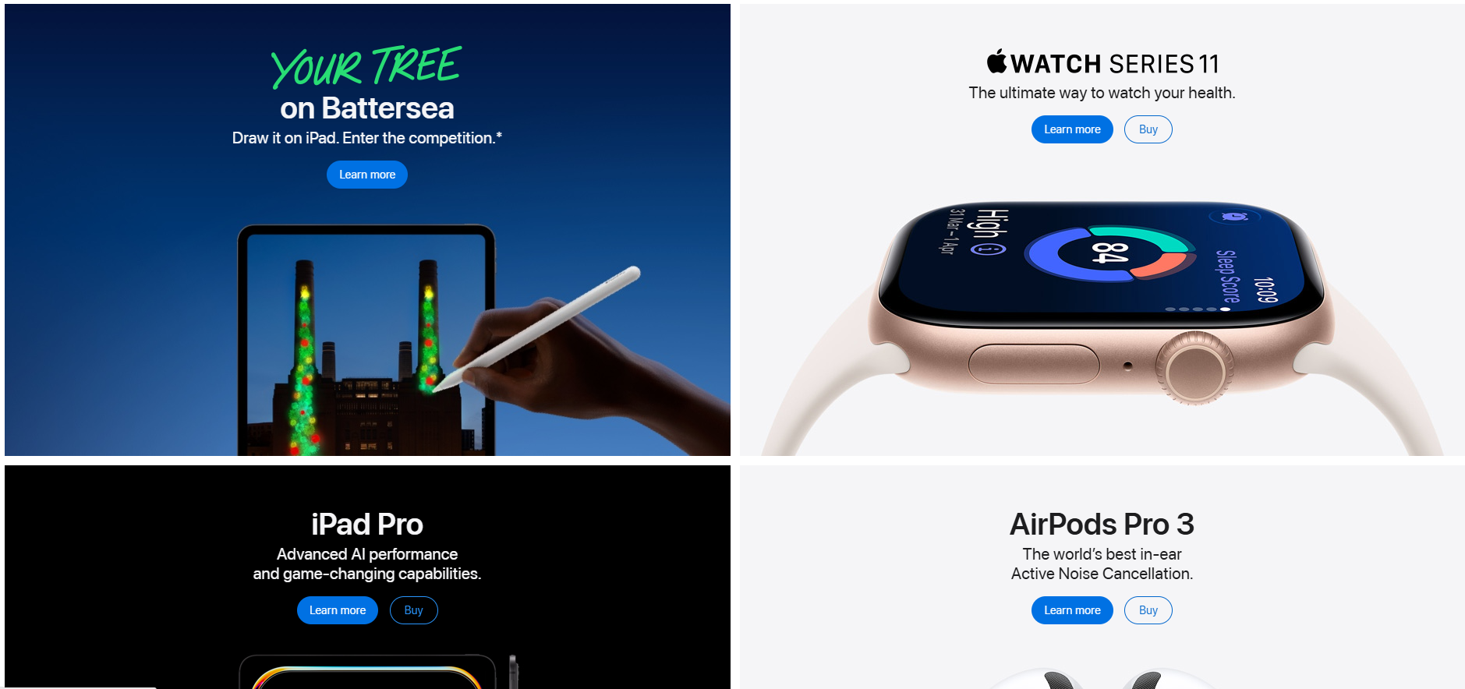
Apple
Apple is a well-designed site
It immediately directs you to the new iPhone and give you an option to buy and learn more
You can scroll down which will then take you to more products such as iPhone Air, MacBook
The design is clean and has a lot of white space which helps direct your attention to their products
When you hover over the selection bar then it will then give you a pop up where you can see more personalised results

Slide 3
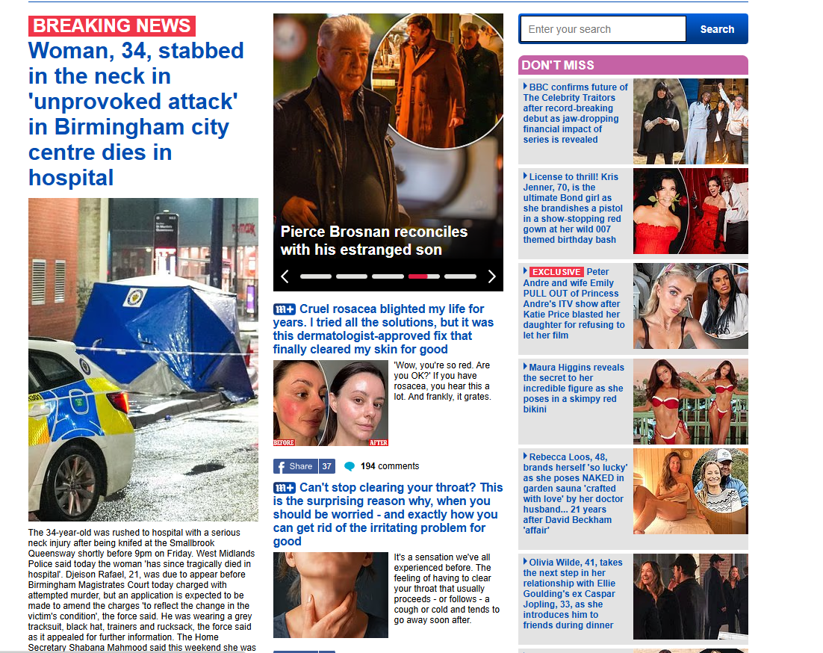
Daily Mail
The Daily Mail website is an example of Bad UI design
The News is cluttered and is very difficult to understand for the user
There is very little white space meaning that the news stories do not stand out and all look the same
Nothing stands it first and it just looks like a jumbled mess and there is no logic in the arrangement
There is not a familiar use of conventions as there Is no drop down for the users to go into more detail

Slide 4
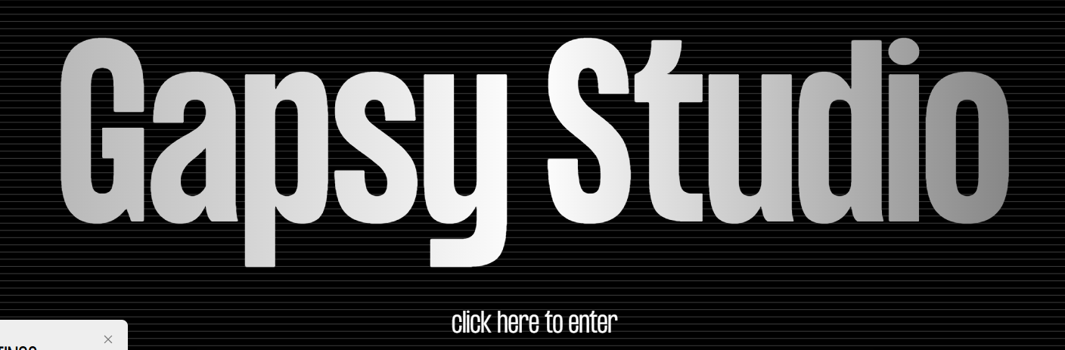
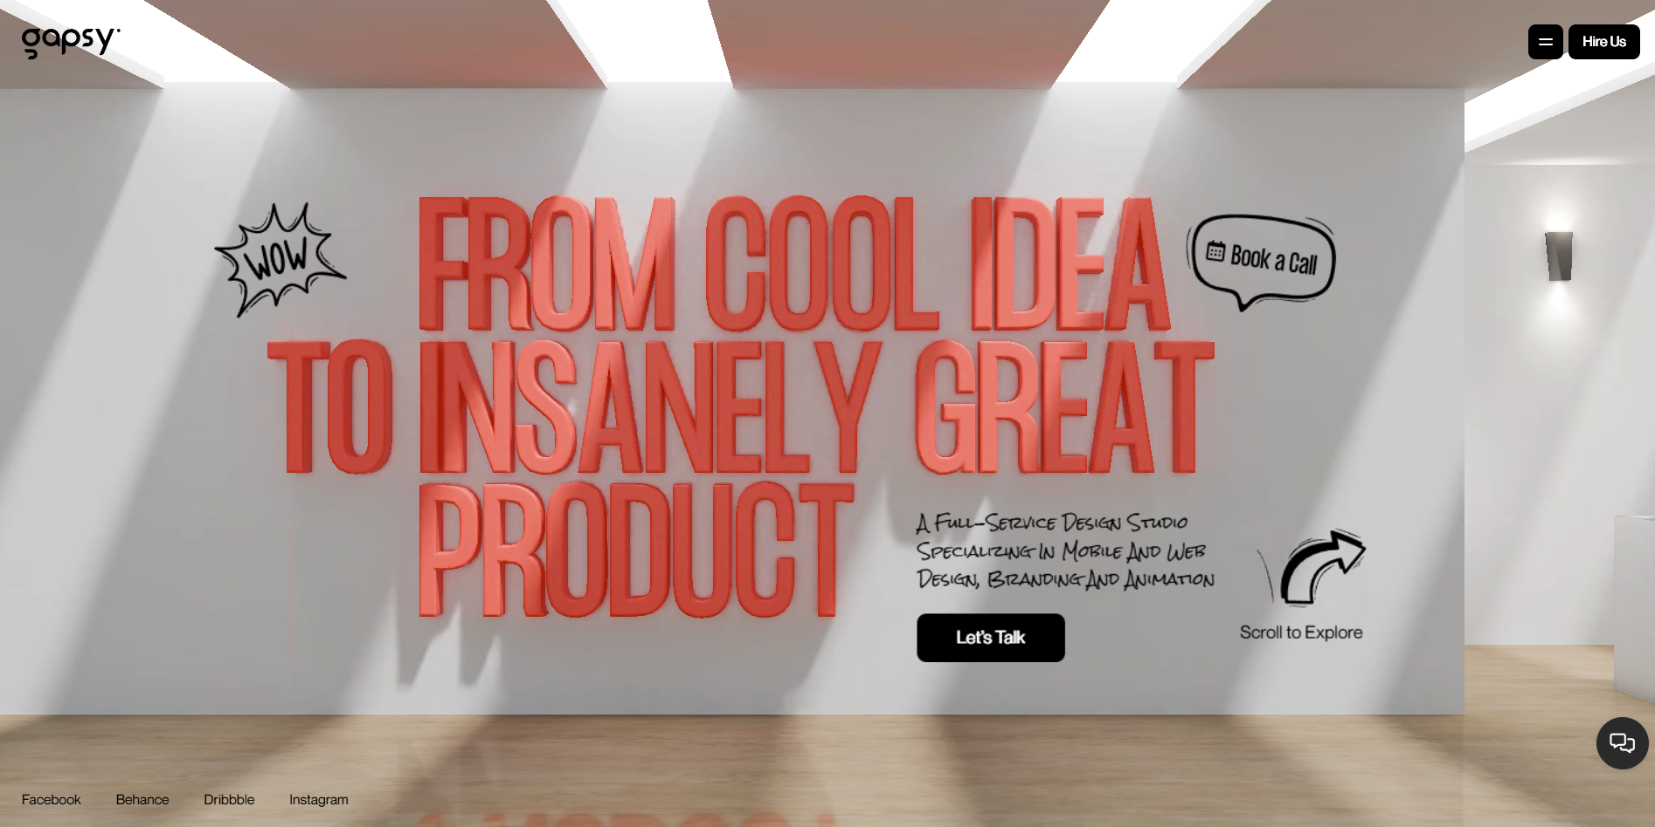
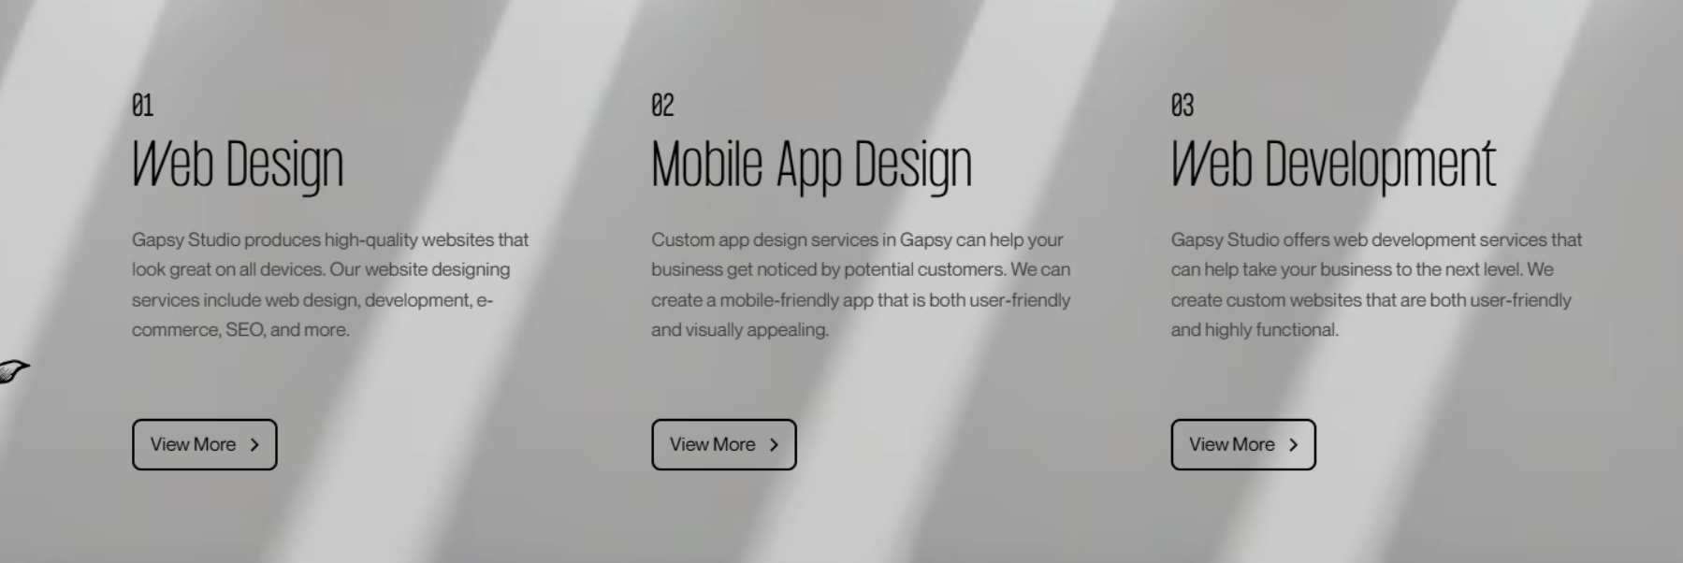
Gapsy Studio
The Layout is unorthodox however is arranged logically and is easy to use. They also make it accessible as they give you help going through the site
There is plenty of white space which helps the key features shine and make it easy to understand what they offer
Key actions and info is seen first
The only familiar conventions they use is the menu bar and buttons other than that you must click to get onto the site(First Photo)
You use your scroll wheel to navigate the site, and the site is 3d allowing for nice and clean transitions

Slide 5
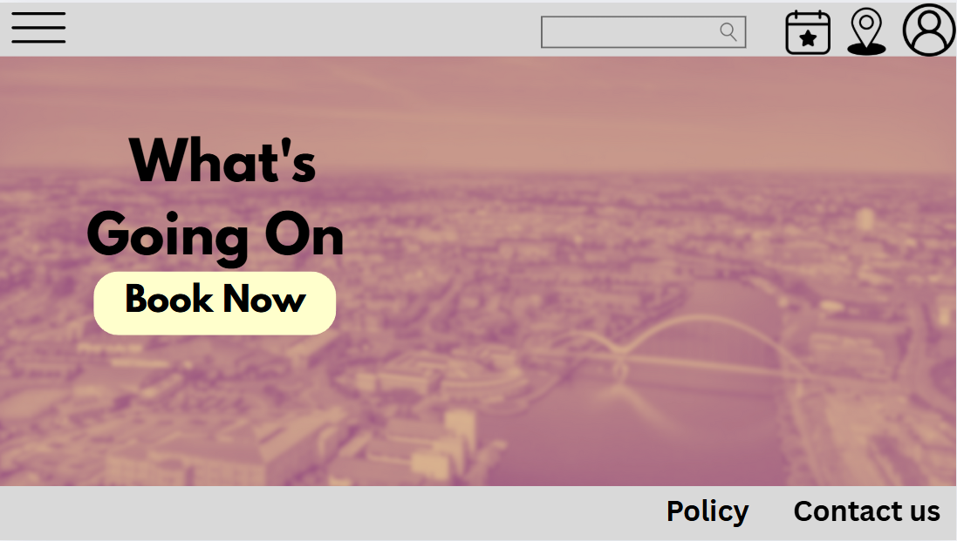
Wireframe

Slide 6
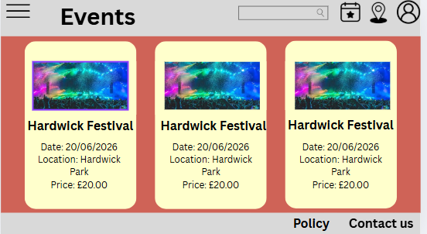

Slide 7
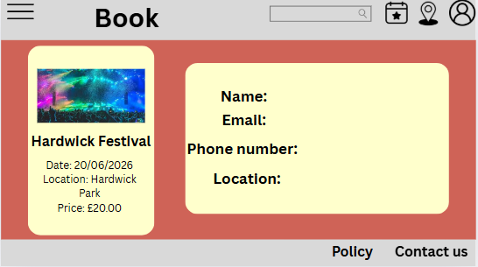

Slide 8
Annotate
The main photo shows the town. I have added a Dawn duotone and blurred it with the intensity of 20. This is so that the photo does not take the vocal point
As the background is a light colour, I have chosen a black text colour to stand out.
I feel this Help the main pieces of information such as what's going on now and book now stand out
I have chosen to give the book now button, so it blends in well with the dawn duotone but still makes the black text stand out.
I have used familiar conventions with the 3 lines for the dropdown menu, a search bar, a calendar for events, a location icon for the map and the profile for the profile/account
I have included the policy and contact us at the bottom s that is where they are most commonly seen so that’s where users will immediately look if they have any concerns.
The image does not take up the full screen, and I have 2 light grey borders at the top and the bottom which helps give space for us to put the icons but also helps the image stand out and draws your eyes to the middle.

